Slide 1
KEYLOGGER
CYBER SECURITY PROJECT
Presented By:
KATHIRVEL LK- Jeppiaar Institute of Technology – B.E/ CSE

Slide 2
OUTLINE
Problem Statement
Proposed System/Solution
System Development Approach
Algorithm & Deployment
Result
Conclusion
Future Scope
References

Slide 3
PROBLEM STATEMENT
The increasing reliance on digital communication and online activities has led to a heightened concern for data security and privacy. However, individuals and organizations face challenges in monitoring and protecting sensitive information exchanged through digital channels. One such challenge is the inability to effectively monitor user activity and detect potential security threats, such as unauthorized access or data breaches.

Slide 4
PROPOSED SOLUTION
Our proposed system entails the development of a keylogger using Python's Tkinter library for the GUI, alongside the pynput library for capturing keyboard inputs. The keylogger records keystrokes and saves them in both text and JSON formats for comprehensive analysis.

Slide 5
SYSTEM APPROACH
Technology Used:
Python: For programming the keylogger functionality.
Tkinter: For building the graphical user interface (GUI).
pynput: For capturing keyboard inputs.
JSON: For storing keystroke data in a structured format.

Slide 6
ALGORITHM & DEPLOYMENT
Initialization: Initialize necessary variables and flags.
Event Handling:
on_press(key): Records pressed and held keys.
on_release(key): Records released keys and manages flag state.
Logging:
generate_text_log(key): Saves keystrokes in a text file.
generate_json_file(keys_used): Saves keystrokes in a JSON file.
Keylogger Control:
start_keylogger(): Initiates keylogging process.
stop_keylogger(): Stops keylogging.

Slide 7
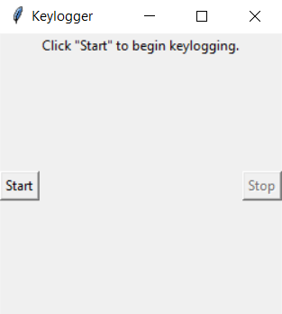
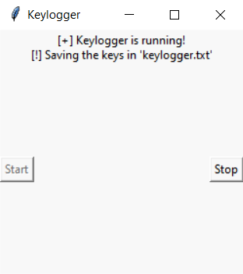
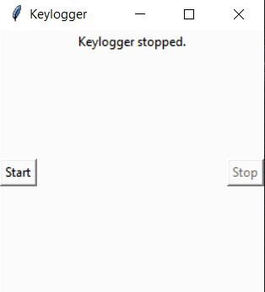
RESULT
The GUI presents "Start" and "Stop" buttons to control the keylogging process. Upon starting, the keylogger captures keystrokes and saves them in designated files. Stopping the keylogger halts the logging process.

Slide 8
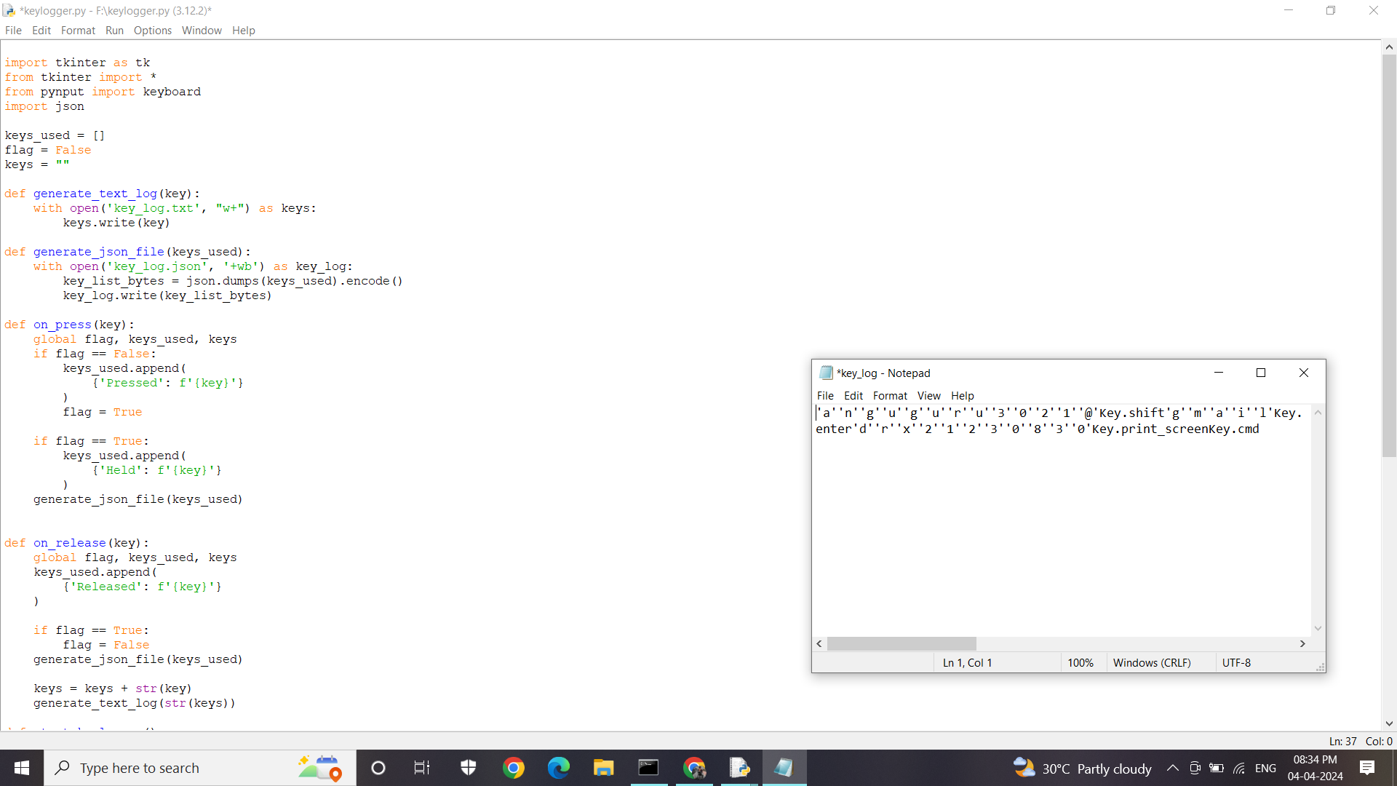
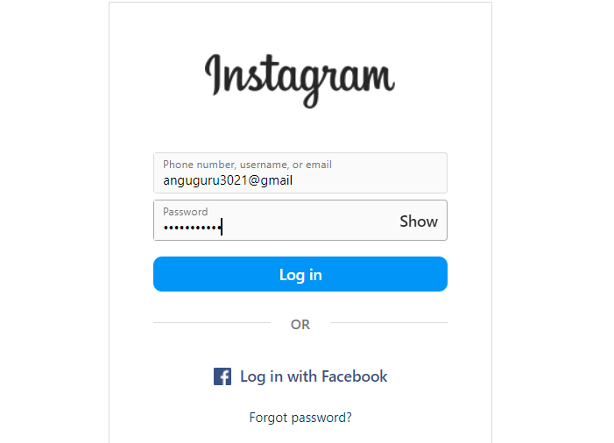
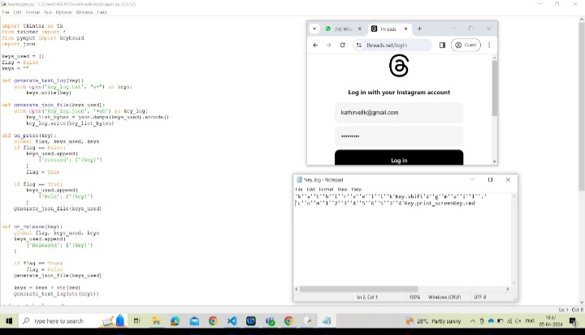
OUTPUT

Slide 9
CONCLUSION
Implementing a keylogger highlights the ease of capturing keyboard inputs and underscores the importance of robust security measures to prevent unauthorized access to sensitive information. Understanding keylogging techniques aids in fortifying systems against potential threats.

Slide 10
FUTURE SCOPE
Enhanced Security Features: Future keyloggers may incorporate advanced encryption and security measures to protect the data they capture. This could involve implementing robust encryption algorithms and secure communication protocols to prevent unauthorized access to logged keystrokes.
Innovative Applications: While the primary use of keyloggers revolves around monitoring user activity, there may be innovative applications emerging in areas such as behavior analysis, user experience optimization, and cybersecurity threat detection.
Advanced Logging: Implement advanced logging features, such as timestamping and window tracking.

Slide 11
REFERENCES
A Survey on Keylogger and its Detection Techniques by Vishal Bharti, Aditya Kumar Gupta, and Shailendra Mishra https://www.ijcaonline.org/archives/volume75/number5/12835-1514
Analysis of Keylogger Attacks and Countermeasures by Hongliang Liu, Ruiying Du, and Quansheng Zhuang https://www.semanticscholar.org/paper/Analysis-of-Keylogger-Attacks-and-Countermeasures-Liu-Du/54c7255bace229c82e4a5fd812ba8dd8829180c1
Detection of Keyloggers: A Review by Shukor Abd Razak, Ku Ruhana Ku-Mahamud, and Ramlan Mahmod https://www.researchgate.net/publication/220955239_Detection_of_Keyloggers_A_Review
A Comprehensive Study on Keylogger Attack and Defense by Shuo Chen, Rui Wang, XiaoFeng Wang, and Kehuan Zhang https://www.usenix.org/legacy/events/sec11/tech/full_papers/Chen.pdf

Slide 12
THANK YOU

